Slide 1
Online Shoppers Intention - Case Study
Preprocessing, Modeling, and Evaluation- Using Logistic Regression
PRADEEPA V
23UIT098
BTECH IT
III YEAR B SECTION

Slide 2
Objective
Explore Online Shoppers dataset
Predict if a user will generate revenue
Apply logistic regression and evaluate

Slide 3
Dataset Overview
Source: online_shoppers_intention.csv
Target: Revenue (0 = No, 1 = Yes)
Features: Bounce Rate, Page Value, Exit Rates, etc.

Slide 4
Preprocessing Steps
Removed duplicates
Filled missing values with forward fill
Encoded categorical data
Scaled features using StandardScaler

Slide 5
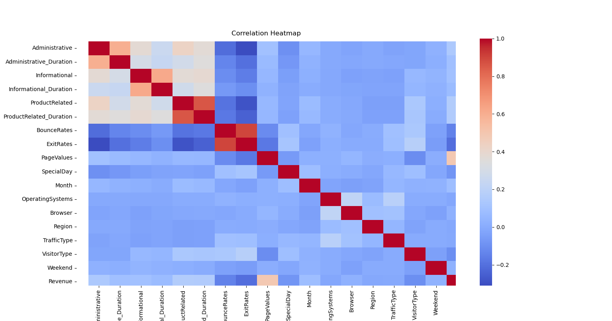
Correlation Heatmap
Helps identify multicollinearity
Visual tool to guide feature selection

Slide 6
Train/Test Split
Used train_test_split from sklearn
80% training and 20% testing
Random state fixed for reproducibility

Slide 7
Model Selection
Logistic Regression used
Binary classification model
Max Iterations: 1000

Slide 8
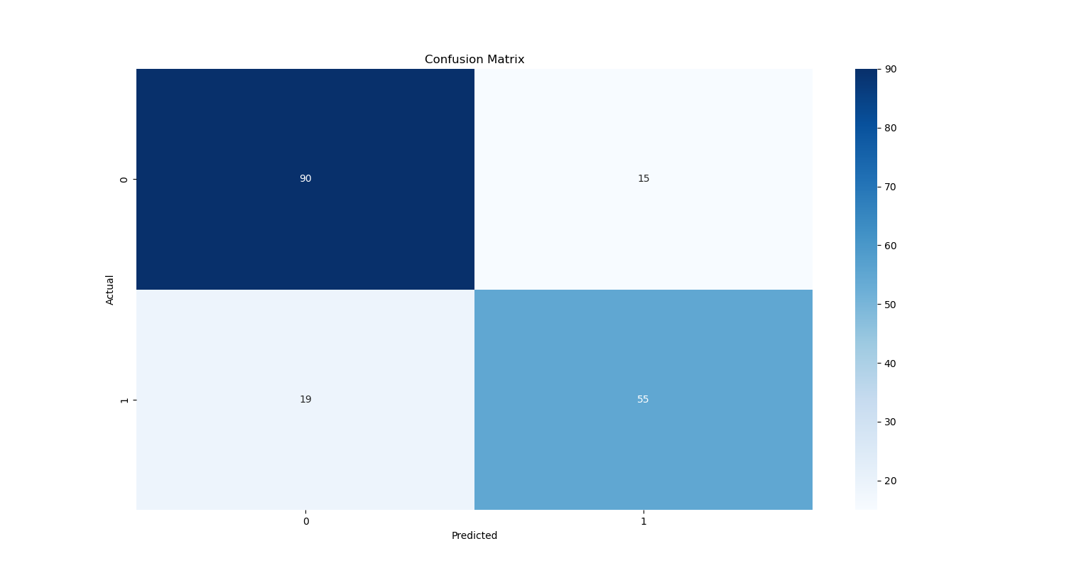
Evaluation Metrics
Confusion Matrix
Classification Report (Precision, Recall, F1-score)
Cross Entropy Loss (Log Loss)

Slide 9
Cross Validation
10-Fold Cross Validation
Used KFold with shuffling
Reported mean accuracy across folds

Slide 10
Train-Test Ratios
Tried different ratios: 80/20, 70/30, etc.
Compared accuracies across splits
Helps evaluate model stability

Slide 11
Titanic Dataset - Case Study
Predicting Survival on the Titanic
Using Logistic Regression
Presented by: Your Name

Slide 12
Objective
Predict passenger survival
Use logistic regression for classification
Evaluate performance using multiple metrics

Slide 13
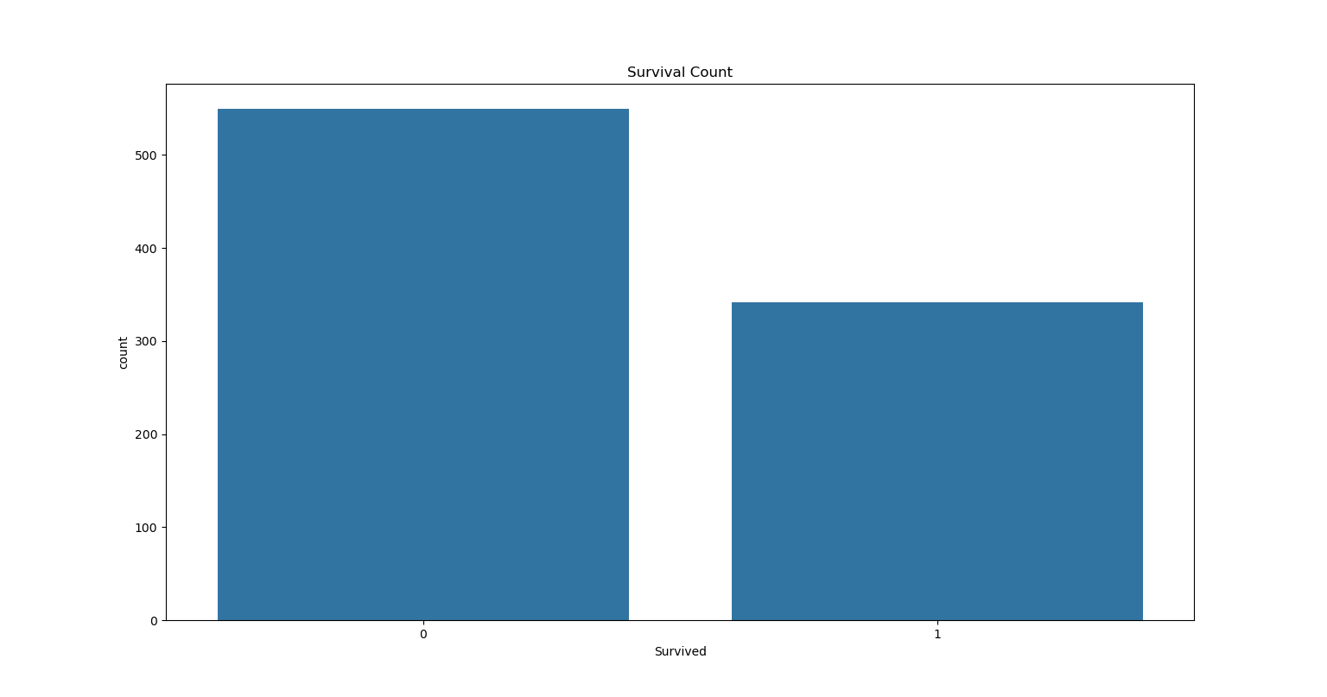
Data Cleaning & Encoding
Dropped: Name, Ticket, Cabin
Encoded: Sex and Embarked
Filled missing Age & Embarked values

Slide 14
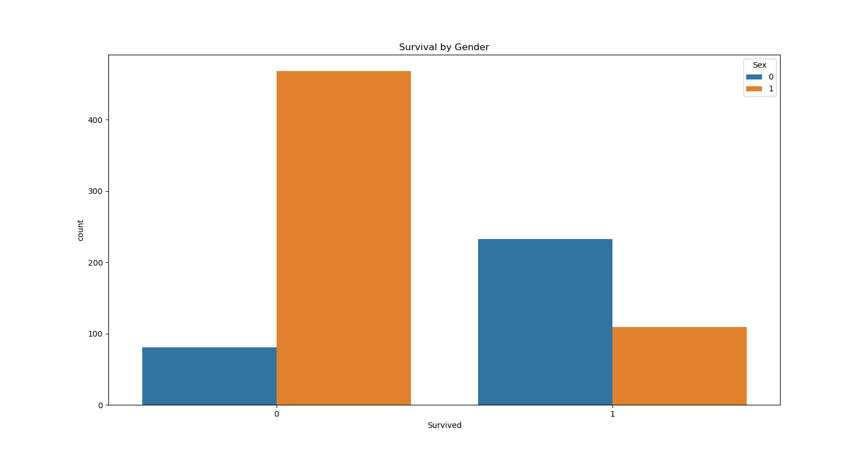
Data Visualization
Survival distribution
Survival by gender
Age distribution using histogram

Slide 15
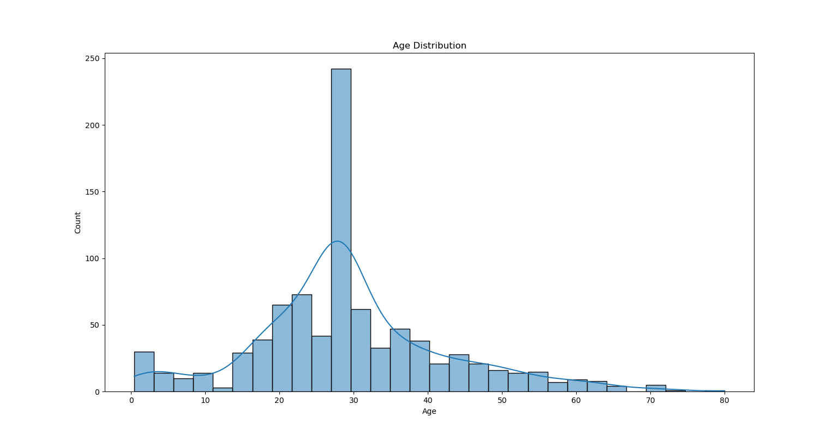
Modeling & Evaluation
Logistic Regression
Evaluation: Accuracy, Log Loss, Confusion Matrix
10-Fold CV and varying train-test ratios

